Slide 1
Case of the week
13/05/2020

Slide 2
A 5-year-old boy represented to emergency with his mother at 11pm after a head injury earlier in the afternoon.
He vomited twice so far and bit drowsy as per mom.
He was seen in ED 2 hours ago and discharged with head injury advice.
Outline the indications for CT head in this child.
Notes:
Decision to do CT scan- depends on clinical features
Mechanism of Injury- Fall from height >1meter, significant MVA, hit by a projectile, NAI etc.
Historical features- Loss of consciousness, multiple- persistent vomiting with no other clear cause, drowsiness, delayed seizures, representation in this particular scenario is a red flag.
Examination findings- GCS <15 >2 hours after the injury, focal neurology, signs of basal skull fracture, depressed skull fracture, penetrating injury, Large laceration or hematoma (>5cm) or boggy swelling, tense frontanelle is infants etc.
Use of various decision-making tools-
PECARN, CHALICE or Catch
NICE or Canadian CT head rules are non validated from Pediatric head injury
Further discussion- Isolated loss of consciousness- significance in minor head injury
Lee LK, Monroe D, Bachman MC, Glass TF, Mahajan PV, Cooper A, , Stanley RM, Miskin M, et al. Traumatic Brain Injury (TBI) Working Group of Pediatric Emergency Care Applied Research Network (PECARN). Isolated loss of consciousness in children with minor blunt head trauma. JAMA Pediatr. 2014 Sep;168(9):837-43. PMID: 25003654

Slide 3
Discuss/ Compare various pediatric head injury decision makings tools?
Notes:
Compare the decision-making tools-
Reference- Easter JS, Bakes K, Dhaliwal J, Miller M, Caruso E, Haukoos JS. Comparison of PECARN, CATCH, and CHALICE Rules for Children With Minor Head Injury: A Prospective Cohort Study. Ann Emerg Med. 2014 Aug;64(2):145-52. PMID: 24635987
Among the 1,009 children, 21 (2% [95% CI: 1%, 3%) had clinically important traumatic brain injuries. Only physician practice and PECARN identified all clinically important traumatic brain injuries.
PECARN (https://www.mdcalc.com/pecarn-pediatric-head-injury-trauma-algorithm)
Sensitivity = 100% [95% CI: 84, 100]
Specificity = 62% [95% CI: 59, 66]
LR + 2.7 [95% CI: 2.5, 2.9]
LR – 0 [95% CI: 0, ?]
CATCH (https://www.mdcalc.com/catch-canadian-assessment-tomography-childhood-head-injury-rule)
Sensitivity = 91% [95% CI: 70, 99]
Specificity = 44% [95% CI: 41, 47]
LR + 1.6 [95% CI: 1.4, 1.9]
LR – 0.2 [95% CI: 0.1, 0.8]
CHALICE (https://www.mdcalc.com/chalice-childrens-head-injury-algorithm-prediction-important-clinical-events-rule)
Sensitivity = 84% [95% CI: 60, 97]
Specificity = 85% [95% CI: 82, 87]
LR + 5.5 [95% CI: 4.3, 7.1]
LR – 0.2 [95% CI: 0.1, 0.5]
Physician practice
Sensitivity = 100% [95% CI: 84, 100]
Specificity = 50% [95% CI: 47, 53]
LR + 2.0 [95% CI: 1.9, 2.1]
LR – 0 [95% CI: 0, ?]

Slide 4
PECARN
Sensitivity = 100% [95% CI: 84, 100]
Specificity = 62% [95% CI: 59, 66]
LR + 2.7 [95% CI: 2.5, 2.9]
LR – 0 [95% CI: 0, ?]
CATCH
Sensitivity = 91% [95% CI: 70, 99]
Specificity = 44% [95% CI: 41, 47]
LR + 1.6 [95% CI: 1.4, 1.9]
LR – 0.2 [95% CI: 0.1, 0.8]
CHALICE
Sensitivity = 84% [95% CI: 60, 97]
Specificity = 85% [95% CI: 82, 87]
LR + 5.5 [95% CI: 4.3, 7.1]
LR – 0.2 [95% CI: 0.1, 0.5]
Physician practice
Sensitivity = 100% [95% CI: 84, 100]
Specificity = 50% [95% CI: 47, 53]
LR + 2.0 [95% CI: 1.9, 2.1]
LR – 0 [95% CI: 0, ?]
Notes:
Reference-
https://emergencymedicinecases.com/beem-cases-pediatric-minor-head-injury/#Jump%20to%20Question%201%20Discussion
“Based on this study, it appears that both clinician gestalt and the PECARN Rule have adequate sensitivity to rule out important injuries at the bedside, with the PECARN rule being slightly more specific than gestalt. Clinicians should be aware that this conclusion is somewhat limited by the wide confidence intervals in is study, and that clinical expertise and shared decision making remain important components of safe discharge of these patients.”

Slide 5
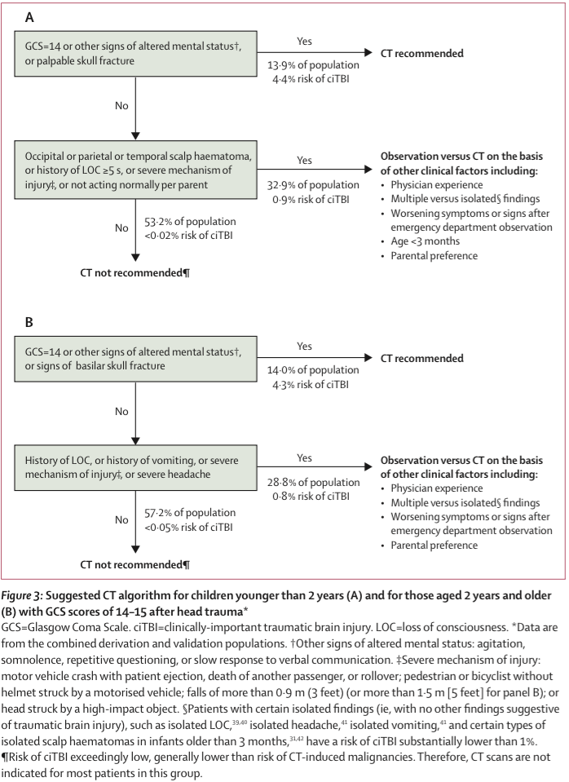
Notes:
PECARN rule for further discussion

Slide 6
Important clinical features after initial assessment-
Fell from a monkey bar more than a meter height
? Loss of consciousness, upset initially on 1st presentation. But no vomiting.
Vomited twice after discharge became increasingly drowsy.
GCS 13 (E 3 V 5 M 5) Otherwise normal vitals. Large hematoma on the right forehead. No sign of basal skull fracture. No Focal neurology.
You have decided to do a CT head.
Notes:
Discussion pediatric GCS <4 years old RCH head injury guidelines
https://www.rch.org.au/clinicalguide/guideline_index/Head_injury/

Slide 7
What are the potential issues in performing the CT?
How will you facilitate the CT scan?
Notes:
Issues-
Pediatric patient for CT head- may no cooperate
Drowsiness- deterioration airway risk
Risk of potential complication of major head injury- Seizure
Radiation exposure- benefits>> risk Pediatric CT radiation exposure and risk- (https://www.aliem.com/pem-pearls-assessing-radiation-risk-in-children-getting-ct-imaging-managing-risk-and-making-medical-decisions/)
Options-
Parental support- mother accompanies the child to CT and stays with a lead gown on inside the room, risk of mother being exposed to CT radiation
Sedation with Midazolam- risk of over sedation- airway risk
Sedation with ketamine- procedural sedation with appropriate monitoring- resource intensive, airway risk
Intubation and then performing CT- in this particular scenario one can argue about the potential severe head injury and necessity of intubation. But intubation will be resource intensive, logistically challenging- transfer, maintaining sedation. Argument against it can be made later if CT head does not show any pathology.

Slide 8
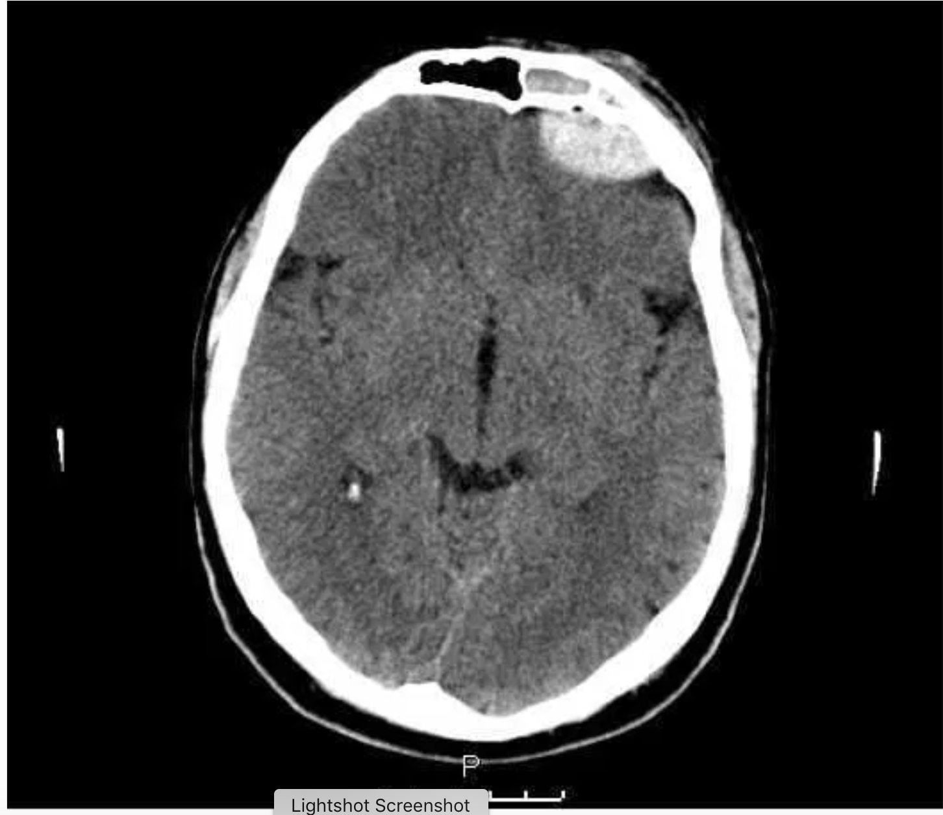
Interpret the CT head
Notes:
Source - ACEM SCE 2013
Relevant Positive-
Extradural haematoma, left anterior cranial fossa Debatable presence/absence of midline shift Approximately 1.5 x 4 cm Left frontal lobe compressed slightly
Fluid in left frontal sinus Air bubble External soft tissue swelling
Relevant Negative-
Remainder of brain normal; no apparent skull fracture seen (but expect on other views).
Interpretation-
Left frontal extradural haematoma adequately described from recent closed head injury. Expect and plan for deterioration. Will need liaison with and care under a neurosurgical service
Radiology masterclass-https://www.radiologymasterclass.co.uk/tutorials/ct/ct_brain_anatomy/ct_brain_anatomy_start

Slide 9
After the CT scan, the patient deteriorates to GCS 5. How will you manage him?
Notes:
Issues-
Possible cause- deterioration of intracranial bleed, seizure
Urgent RSI
Prevention secondary neurological damage due to elevated CPP and potential complications
Urgent referral and transfer to Neuro surg at PCH for evacuation of EDH
Communication with family
Management-
Pediatric resuscitation calculator-
http://kidshealthwa.com/wp-content/uploads/calculators/Emergency-Calculator-v9-2/EmergencyCalculator.htm
Resus area, allocate roles
Prepare for urgent intubation- staff, area, equipment, monitoring, drugs, post intubation care
Most experience intubator
Induction- Ketamine 1.5mg/kg, paralysis- Rocuronium 0.6 -1.2mg/kg
Gentle laryngoscopy
Post intubation sedation- Ketamine/ fentanyl
Prevention of secondary neurological damage-
Cerebral perfusion pressure- head up 30 degrees, no neck ties, ventilation to maintain normal pCO2 and pO2, 3% NaCl 3ml/kg
Maintain sedation and paralysis
Prevent hypothermia, hypo- hypertension
Prevent seizures
Prevent Hypo- hyper glycaemia
Other supportive measures- FAST HUGS IN BED
Disposition and transfer-
Early discussion with Neuro surg
Arrange transfer to PCH
Communication with family

Slide 10
Concerns were raised regarding the management of the initial presentation were brought to your attention.
Outline actions required to deal with those concerns.
Notes:
Discussion- Dealing with near misses/ adverse clinical outcomes/ complaints are integral part of an Emergency consultant job. As a registrar we rarely have to deal with these issues.
When a concern is raised-
What is the concern? The impact of the incidence.
Rectify the source of concern or complaint if possible
Acknowledge the issue
Investigate- Clinical notes, meeting with involved staff. Analysis the cause of the incident.
Usually those incidences are multifactorial
Systemic issues- access block, over crowding, busy department, failure of processes, lack of supervision etc.
Individual failures- lack of medical expertise, skills, unconscious incompetence, communication failure, documentation issues etc.
Response-
Acknowledge concern/ issue- express regret/ concern for welfare/ sympathy
Avoid being judgmental
Rectify the source of concern in a system level or individual level
System- guidelines/ policies, early warning signs, improving clinical supervision, quality improvement audits
Individual- education, simulation, constructive feedback, appropriate support
Documentation
On going quality improvement process
Involve medico-legal team if necessary
Further reading- Emergency medicine manual, 4th edition Dunn
ShakEM emergency fellowship notes

Slide 11
References-
https://emergencymedicinecases.com/beem-cases-pediatric-minor-head-injury/#Jump%20to%20Question%201%20Discussion
https://www.rch.org.au/clinicalguide/guideline_index/Head_injury/
https://web.archive.org/web/20170218172737/http://lifeinthefastlane.com/facem-sce-2013-1-006
https://www.radiologymasterclass.co.uk/tutorials/ct/ct_brain_anatomy/ct_brain_anatomy_start
https://www.aliem.com/pem-pearls-assessing-radiation-risk-in-children-getting-ct-imaging-managing-risk-and-making-medical-decisions/
Emergency medicine manual, 4th edition Dunn
ShakEM emergency fellowship notes
ACEM Fellowship SCE 2013

